Slide 1
FACEBOOK USER EXPLORATORY DATA ANALYSIS
Assignment Showtime Consulting

Slide 2
Assignment – Introduction
Domain: Social Media
Topic : Exploratory Data Analysis on Facebook Utilization Data
Project Introduction
Facebook is a popular free social networking website that allows registered users to create profiles, upload photos and video, send messages and keep in touch with friends, family and colleagues. A lot of data are generated on Facebook daily basis. Here, we are going to look at an anonymized dataset named Facebook user data - Facebook user data.csv. We are interested in looking at the various trends gender, age-group, etc. and Identify a pattern out of it.

Slide 3
Dataset Description and Missing Data
Attribute Information:
Userid: ID of user
Age: User’s age(years)
dob_day: Day of date of birth(1-31)
dob_year: Year of date of birth
dob_month: Month of date of birth
gender : M/F
tenure : How long have facebookusers been on site
friend_count: Total number of friends
friendships_initiated: Number of friendships initiated by the user
likes : Total number of likes by user
likes_received: Total number of likes received by user
mobile_likes: Number of likes by user (through mobile)
mobile_likes_received: Number of likes received by user (through mobile)
www_likes: Number of likes by user (through desktop website)
www_likes_received: Number of likes received by user (through desktop)

Slide 4
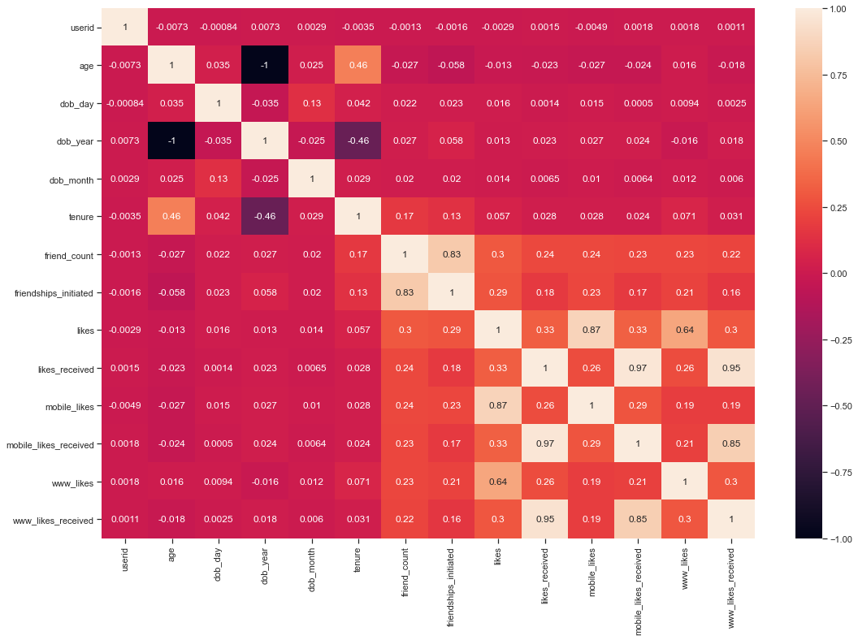
Plot heatmap / correlation matrix on all the columns

Slide 5
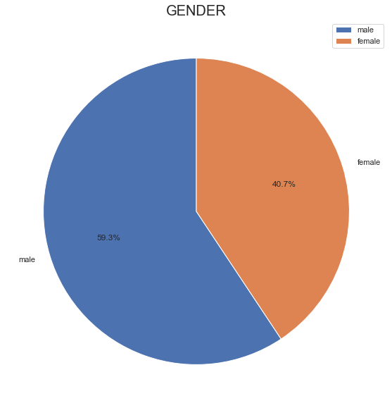
Question-1 - Analysis based on gender of the users
Composition of male and female users

Slide 6
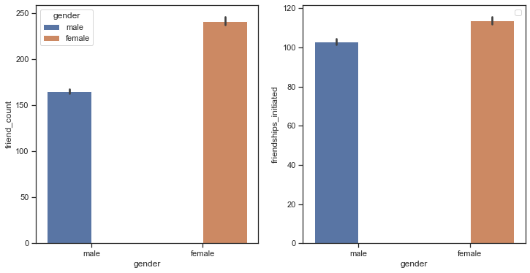
Category of gender initiated more friendships Category of gender has more friends

Slide 7
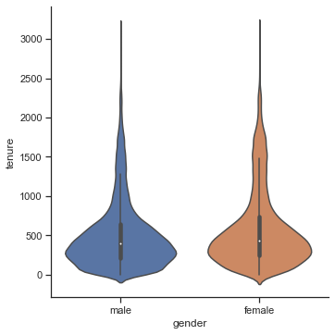
Distribution of tenure across different categories of gender

Slide 8
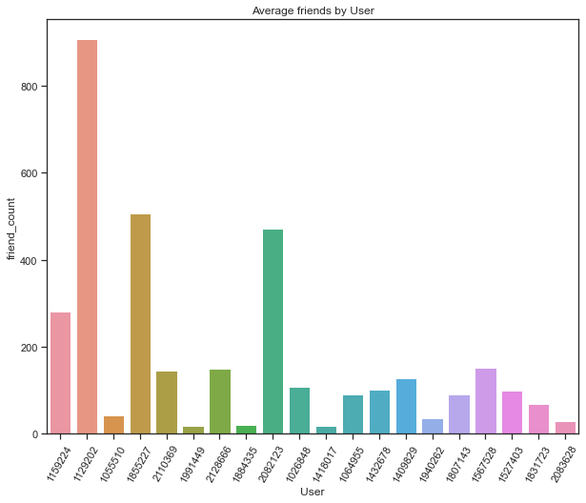
Question-2 Analysis based on the least active users on Facebook
How many users have no friends

Slide 9
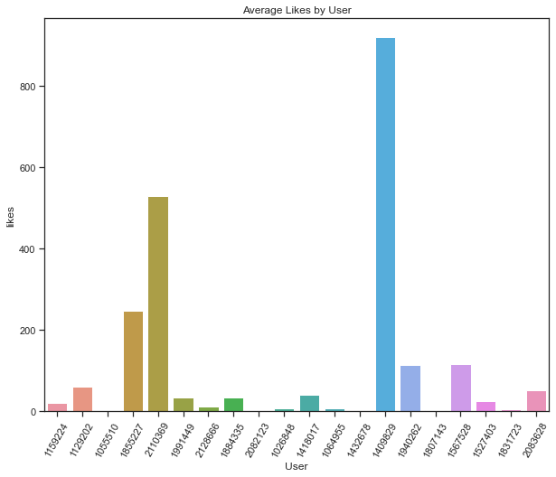
How many users did not like any posts

Slide 10
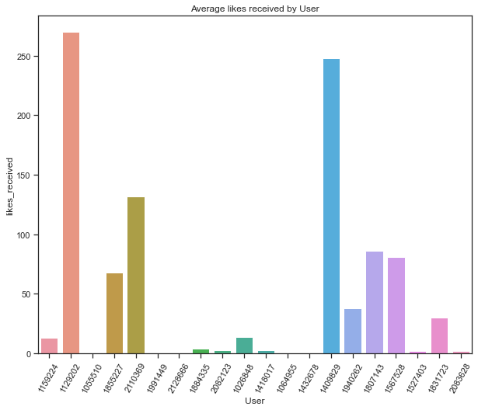
How many users did not receive any likes

Slide 11
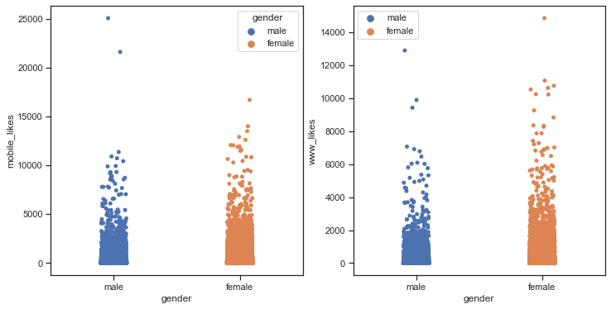
Qusetion-3 Analysis based on the user accessibility (Mobile Devices vs. Web Devices)
Average number of posts liked by users (based on gender) through web vs. Mobile devices

Slide 12
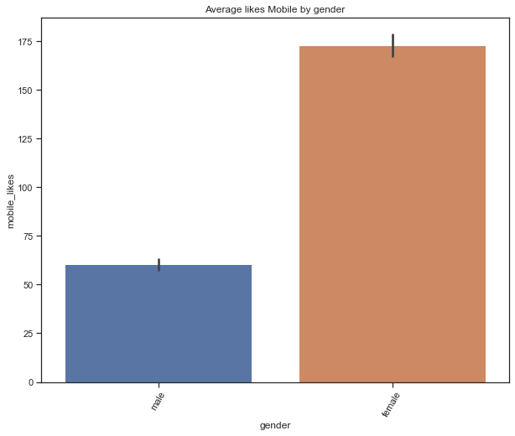
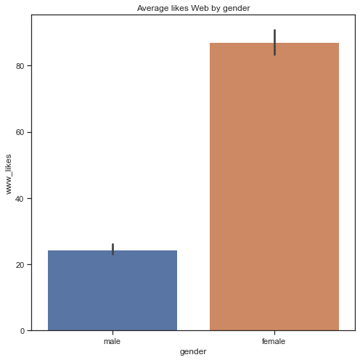

Slide 13
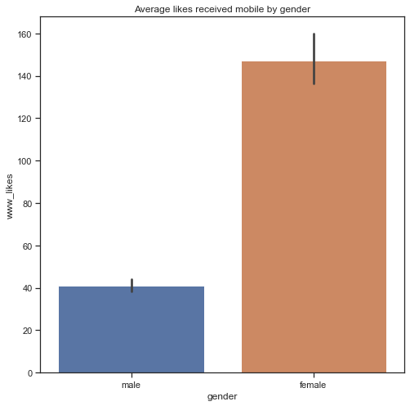
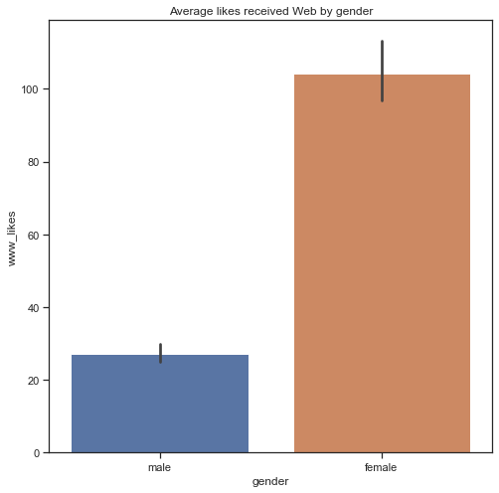
Average number of likes received by users (based on gender) through web vs. Mobile devices

